Slide 1
SPACE Ways to create the illusion of space (depth) in an artwork

Slide 2
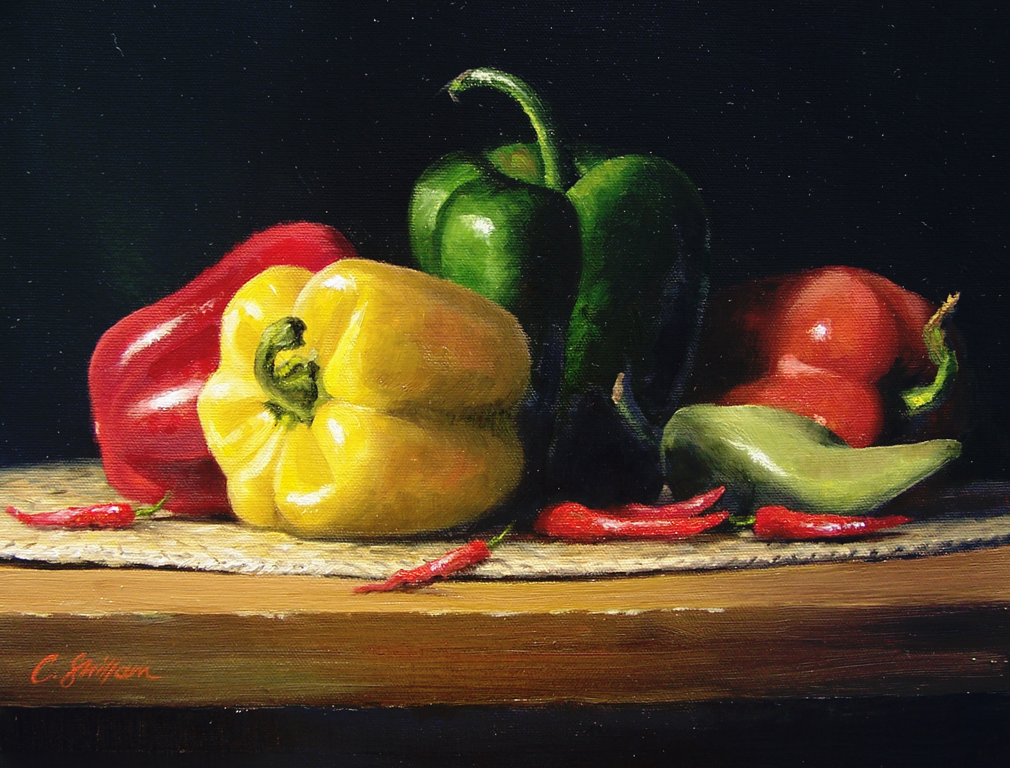
Overlapping
Overlapping objects..Objects appear to be in
Front or behind other objects.

Slide 3
Placement…
Objects that are nearer appear closer to the bottom of the Picture plane (paper, canvas). Objects that are farther away appear towards the top of the picture plane (paper, canvas)

Slide 4
Size of objects
Objects that are near appear to be larger than objects that are far.

